Slide 1
Welcome to the 2020 Awards Recognition Ceremony
85th International Conference |Virtually everywhere

Slide 2
Marty Baker Graham Research Grant
Sponsored by Friends and Family of Marty Baker Graham
Nupoor Ranade
North Carolina State University
“Re-Contextualizing Audiences in User-Generated Content Publication Spaces”
Notes:
During her career in higher education, Dr. Marty Graham (Iowa State University) worked diligently to support the advancement of graduate students, particularly female, non-­traditional students. Because of her dedication to these students and her understanding of the economic difficulties all graduate students face, her family and friends have endowed the Margaret (Marty) Baker Graham Research Grant. This award will assist doctoral students engaged in research within the discipline of business communication. Distributed through the C. R. Anderson Foundation, the $500 award will be presented at the Annual International Conference of the Association for Business Communication.

Slide 3
Award for Excellence in
Communication Consulting
Sponsored by APCC and ABC
Theomary Karamanis
Cornell University
SC Johnson College of Business
Notes:
The Association of Professional Communication Consultants (APCC) and the Association for Business Communication (ABC) invite full- and part-time communication consultants to apply for a jointly sponsored, annual Award for Excellence in Communication Consulting. The award winner, to be named at the 2019 ABC International Conference, will receive $1,500 and a free registration to the 2020 ABC conference, with an invitation to present his or her project at that conference.
The award may be presented in one of three categories: Excellence in Writing, Excellence in Training, and Excellence in Electronic Media

Slide 4
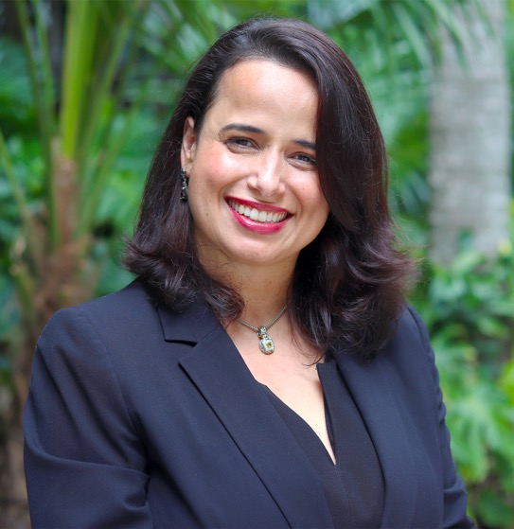
Distinction in the Practice of
Diversity and Inclusion
Sponsored by Peter Cardon
Larissa Ramos
University of Miami
Miami Herbert Business School
Notes:
The Award for Distinction in the Practice of Diversity and Inclusion celebrates and recognizes practices that foster community outreach and diversity/inclusion. It honors work outside the classroom, engaging a community that would be deemed non-dominant. This is work that creates partnerships to effect positive social change, whether the change be on an individualized level or on a broader, system-wide, policy level--or a synergistic blend. The chair of the Diversity and Inclusion Committee presents the Distinction in the Practice of Diversity and Inclusion Award during the annual conference.

Slide 5
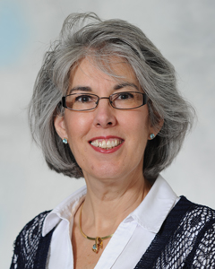
Rising Star Award
Sponsored by SAGE
Susan Schanne
Eastern Michigan University
Notes:
The Rising Star Award recognizes the meaningful contributions to the mission and membership of the Association and to the field at large through excellent teaching, research, and/or practical applications (e.g., consulting, training). This award is intended for members who have been active in the Association for no more than 10 years and who are currently in good standing.

Slide 6
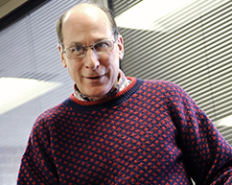
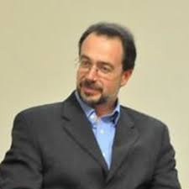
Distinguished Book on
Business Communication
Sponsored by SAGE
Bruce Maylath & Kirk St. Amant
Translation and Localization: A Guide for Technical and Professional Communicators
Published by Routledge

Slide 7
Outstanding Publication in the
International Journal of Business Communication
Sponsored by Paula Lentz and Kathy Rentz
Cen (April) Yue
University of Florida
Co-authors Men, L. R., & Ferguson, M. A. “Examining the effects of internal communication and emotional culture on employees’ organizational identification. ”
Notes:
The Rising Star Award recognizes the meaningful contributions to the mission and membership of the Association and to the field at large through excellent teaching, research, and/or practical applications (e.g., consulting, training). This award is intended for members who have been active in the Association for no more than 10 years and who are currently in good standing.

Slide 8
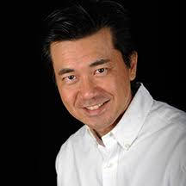
Outstanding Article on Business Communication in a Non-ABC Journal
Sponsored by ABC
Augustine Pang
Co-authors Le, P., Teo, H., Li, Y., & Goh C.
Singapore Management University
“When is silence golden? The use of strategic silence in crisis communication.”
Notes:
English for Specific Purposes Volume 52, October 2018, Pages 27-46

Slide 9
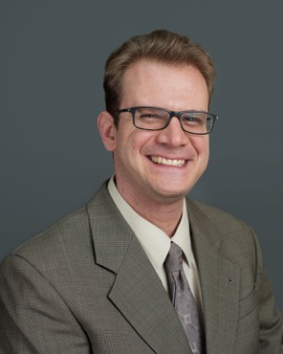
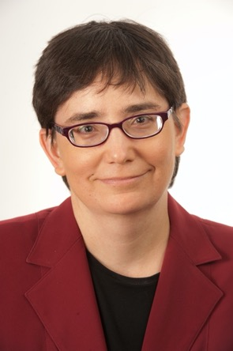
Outstanding Article in the
Business & Professional Communication Quarterly
Sponsored by Mary Ellen Guffey and Dana Loewy
Jeremy Rosselot-Merritt & Janel Bloch
University of Minnesota &
Northern Kentucky University
“Mentoring in business and professional communication: Case study of a multiyear dynamic”

Slide 10
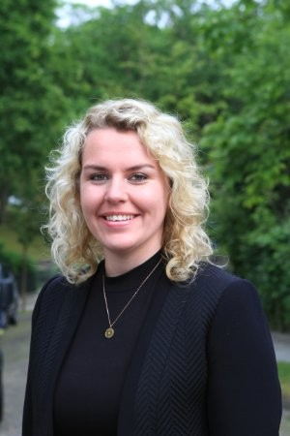
Outstanding Dissertation Award
Sponsored by a Special Friend of ABC
Doreen Hanke
McNeese State University
“Can employees motivate themselves? The link between peer motivating language and employee outcomes ”

Slide 11
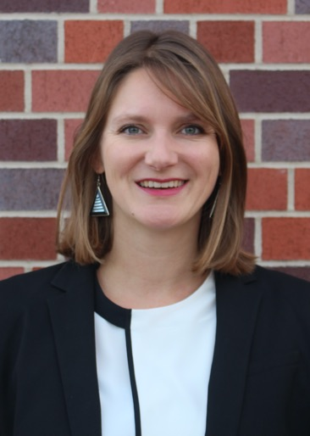
Innovation in Teaching with Technology
Sponsored by Amy Newman
Carolin Fleishmann
University of Southern California (USC)
Marshall School of Business

Slide 12
Meada Gibbs
Outstanding Teacher-Scholar Award
Sponsored by ABC
Paula Lentz
University of Wisconsin-Eau Claire
Notes:
5
Business Communication Quarterly
,Volume 71,Number 1,March 20085-9DOI:10.1177/1080569907313147© 2008 by the Association for Business Communication
THE 2007 MEADA GIBBSOUTSTANDING TEACHER AWARD
Editor’s Note:
In lieu of this issue’s editorial, I am pleased to offer instead two piecesrelated to the 2007 Meada Gibbs Outstanding Teacher Award, which was presentedto Carol Roever at the Annual Convention in Washington, DC, in October 2007. A brief history of the award and an introduction to Carol’s achievements is offered by MarilynDyrud, Chair of the ABC Teaching Committee, which coordinates the nomination andselection process for this award. Following this introduction, you will find Carol’s state-ment of her teaching philosophy, submitted as part of her nomination packet. Herteaching philosophy stands as an especially memorable statement of the central val-ues that guide good teaching—even, as Carol reminds us, in the face of our need toconstantly change and adapt to our ever-evolving field.
AN INTRODUCTION
Marilyn A. Dyrud
Chair, Teaching Committee
ABC’S OUTSTANDING TEACHER award was established in 1989to recognize and reward excellence in teaching business communica-tion. David Bateman,association president in 1987,was the first recip-ient,chosen from a field of more than a dozen exemplary nominees.The Teaching Methodology and Concepts Committee,chaired byDr. Meada Gibbs,spent long hours agonizing over its decision.I remember well those deliberations,as this was my first year onthe committee and I was still a clueless newbie. As I read over pilesof positively luscious credentials,the sense of my own pedagogicaleffectiveness diminished appreciatively:These were indeed giants.Under Meada’s gentle tutelage,the committee finally reached a decision,and a precedent was set for the years to follow.In 1996,the award was renamed in honor of Meada,for her signifi-cant contributions to the organization. The dean of the Graduate Schoolat North Carolina A&T State University in Greensboro,North Carolina,Meada also served as ABC’s first vice-president. Tragically,she died of complications after being involved in an automobile accident.

Slide 13
Kitty O. Locker
Outstanding Research Award
Sponsored by McGraw-Hill and ABC
Kirk St. Amant
Louisiana Tech
Notes:
Kitty O. Locker was an Associate Professor of English at the Ohio State University, where she taught courses in workplace discourse and research methods. In 1994-95, she served as President of the Association for Business Communication (ABC). From 1997 to 2000, she edited ABC's Journal of Business Communication. She received ABC's Outstanding Researcher Award in 1992 and ABC's Meada Gibbs Outstanding Teacher Award in 1998. Kitty Locker passed away in 2005.

Slide 14
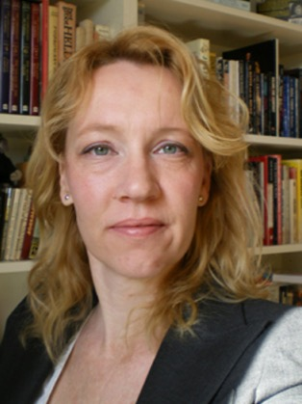
Business Communication Impact Award
Sponsored by the Marshall School of Business, University of Southern California
Ann Kankaaranta & Brigitte Planken
Aalto University & Radboud University
“BELF Competence as Business Knowledge of Internationally Operating Business Professionals”
International Journal of Business Communication

Slide 15
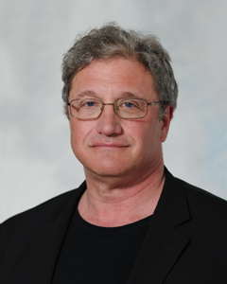
Francis Weeks Award of Merit
Sponsored by ABC
David Victor
Eastern Michigan University
Notes:
The purpose of the Award of Merit in Memory of Francis W. Weeks is to acknowledge, foremost, contributions to the profession, and to recognize outstanding advancement in the discipline of business communication through a singular accomplishment or a series of accomplishments. ED from 1957-1984, Francis W. Weeks, University of Illinois

Slide 16
Bernadine Branshaw
Spirit of ABC Award
Sponsored by ABC
Jacquelyn Lowman
University of Maine at Presque Isle
Notes:
The award recognizes, on an extraordinary basis, exceptional members of ABC who exemplify friendliness and openness to both newcomers and current members. This member’s spirit of friendliness shows a genuine appreciation to all individuals who attend ABC activities.

Slide 17
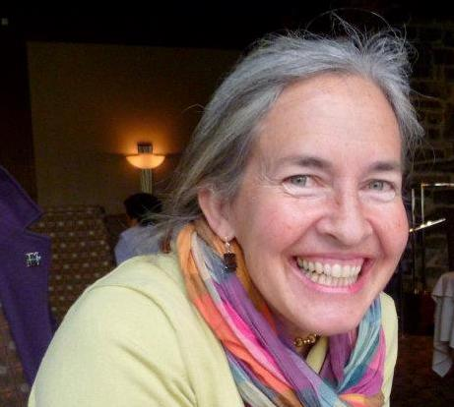
Honorary Member Award
Sponsored by ABC
Marilyn Buerkens
ABC & Virtually Everywhere

Slide 18
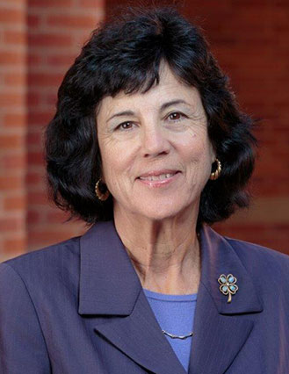
Distinguished Member Award
Sponsored by ABC
Janis Forman
University of California, Los Angeles (UCLA)
Notes:
the Distinguished Member Award is to acknowledge long-term service to the Association for Business Communication and to the discipline. The award identifies excellence in areas important to the teaching of communication as well as to advancing communication as a discipline

Slide 19
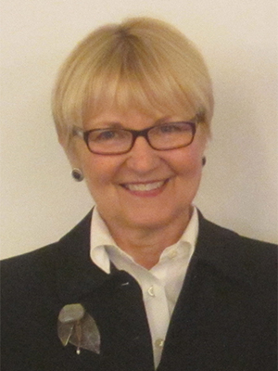
Fellow of ABC Award
Sponsored by ABC
Priscilla Rogers
University of Michigan
Notes:
The Fellow of the Association Award recognizes extraordinary excellence in the discipline of business communication and its related areas of study. It is the most respected honor the Association can award.

Slide 20
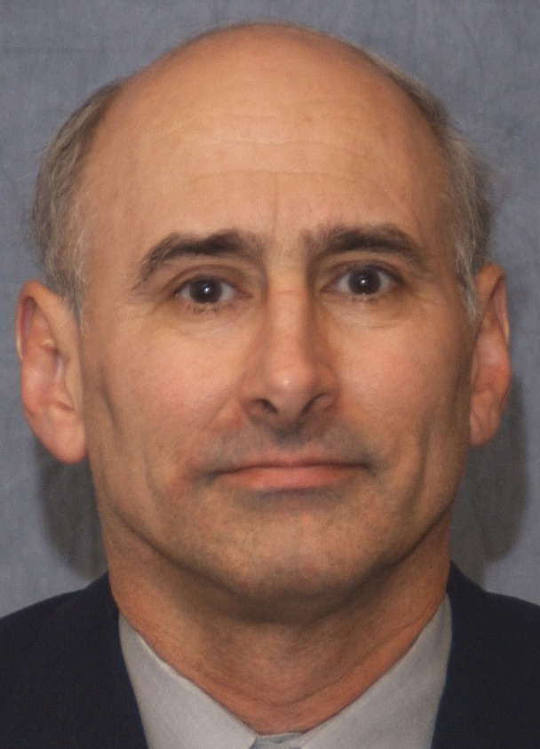
Fellow of ABC Award
Sponsored by ABC
Charlie Kostelnick
Iowa State University
Notes:
The Fellow of the Association Award recognizes extraordinary excellence in the discipline of business communication and its related areas of study. It is the most respected honor the Association can award.

Slide 21
Fellow of ABC Award
Sponsored by ABC
Geert Jacobs
Ghent University
Notes:
The Fellow of the Association Award recognizes extraordinary excellence in the discipline of business communication and its related areas of study. It is the most respected honor the Association can award.

